Slide 1
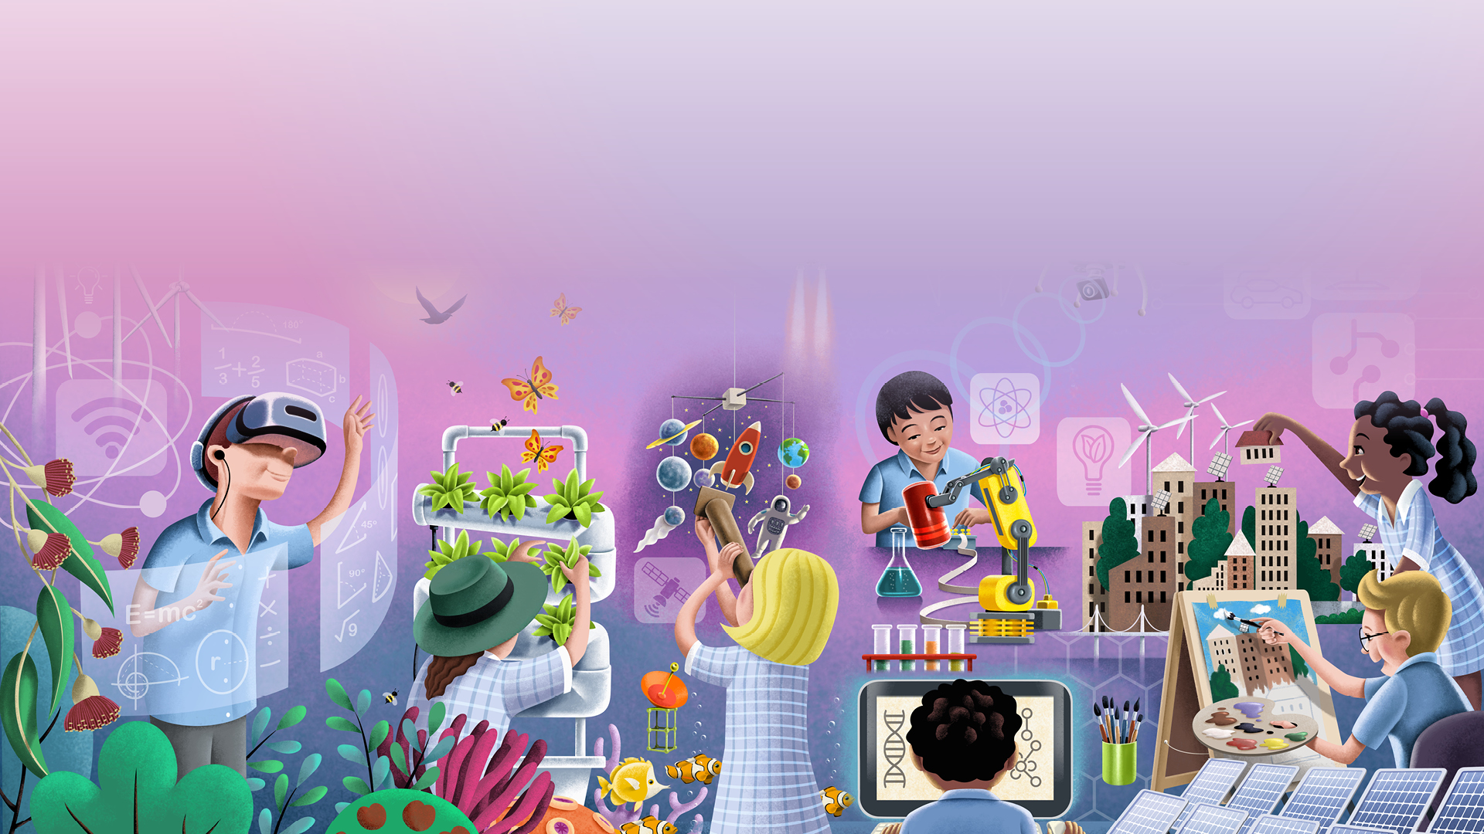

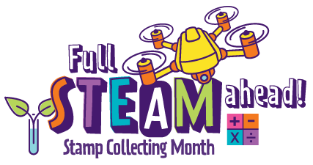

Smart Solutions Classroom Activity Guide

Slide 2


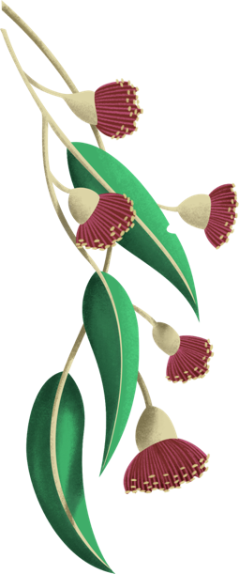
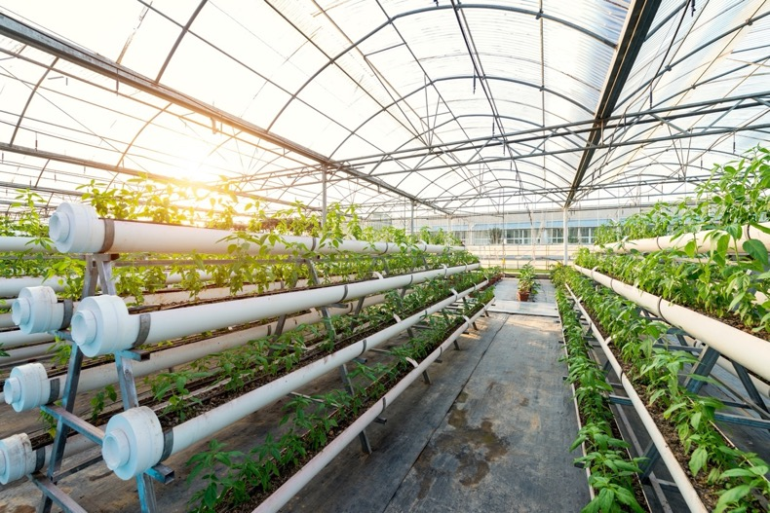
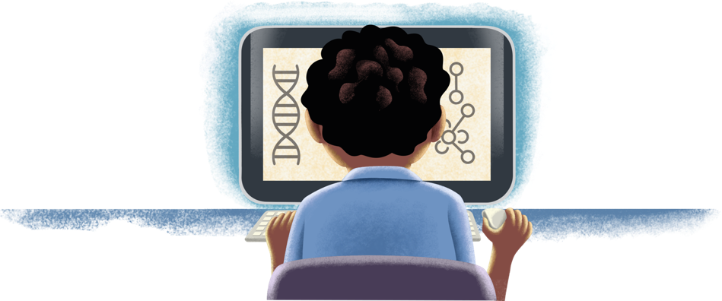
Who is this slideshow for?
This READ ALOUD Interactive Slideshow is for primary classes taking part in Australia Post Stamp Collecting Month 2021. It introduces the Smart Solutions! unit, one of three innovation themes of this year’s Full STEAM Ahead! program.
The slideshow examines how advances in technology are changing how we produce energy and food, how our cities are designed and much more. It features background information, quizzes and thought-provoking discussion questions intended to extend your students’ thinking about technology and STEAM-learning.
Teachers should read through and discuss this slideshow with their class. Some of the topics discussed raise ethical issues. Teachers should use their discretion when introducing some of these themes.
The content in this slideshow is linked to the Australian Curriculum. For more detail, please see the
Australia Post Stamp Collecting
Month 2021 Teacher Guides.
The Teacher Guides provide
a range of complementary
activities and investigations.

Slide 3









Green Energy
Most experts believe that the future of electricity production lies in sustainable energy, such as wind and solar energy.
To reverse global warming we must find cleaner energy sources, that do not pollute the planet. Some forms of green energy have been used for thousands of years.
Did you know the ancient Greeks and Romans used solar energy in their homes over 2000 years ago?
They designed their homes to take advantage of the sun. This helped them to be cooler in summer and warmer in winter. They used the sun by:
placing most of the openings, such as doors and windows, on the southern side of the house which received by far the most sun
putting extra insulation on the walls of their homes which faced away from the sun (insulation methods included using mud and straw inside cavity walls).
In Australia, lots of our energy for heating, cooling and other purposes does not come from sustainable sources. But we are increasingly using more electricity from sources such as:
solar energy, from the sun
wind energy
geothermal energy, which uses heat from beneath the earth
marine energy, from tides, waves or ocean currents
bioenergy, from farm waste.

Slide 4

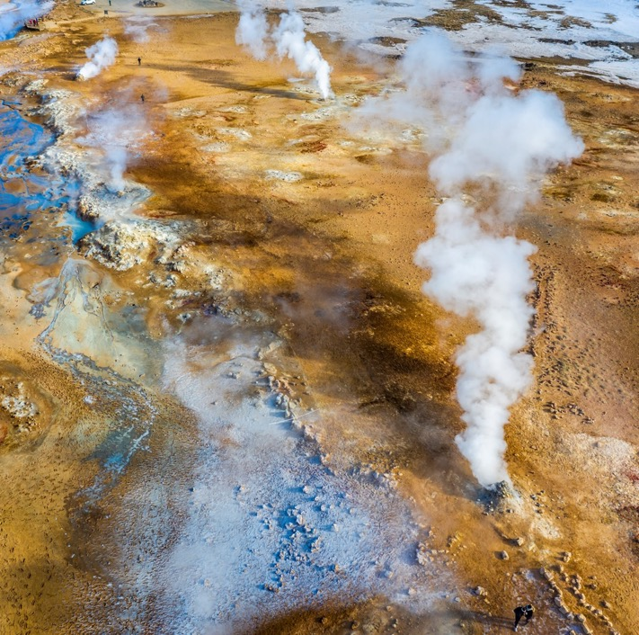
Text: Quick Quiz! 1
Geothermal energy uses the natural heat stored in hot rocks and hot water beneath the surface of the earth. This heat is used to boil water which produces steam. The steam is used to spin turbines which produces electricity.

Slide 5
Answers 1
Geothermal energy uses the natural heat stored in hot rocks and hot water beneath the surface of the earth. This heat is used to boil water which produces steam. The steam is used to spin turbines which produces electricity.
Indonesia, the Philippines and New Zealand are some of the world’s biggest producers of geothermal energy.
They are all located in our region, the Asia-Pacific.
Can you find them on a map?
All three countries are located in an area called the ‘Ring of Fire’, which borders the Pacific Ocean. There are lots of natural geothermal features in the ‘Ring of Fire’, such as volcanoes, hot springs and geysers.

Slide 6
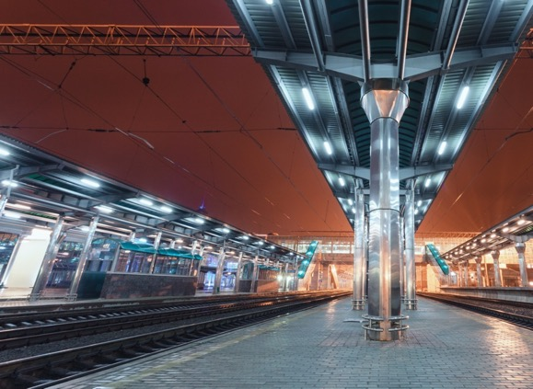

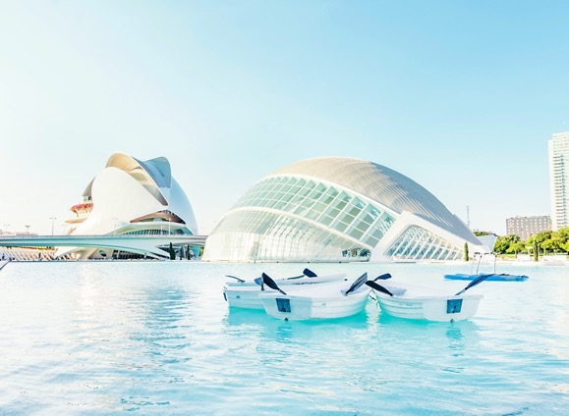
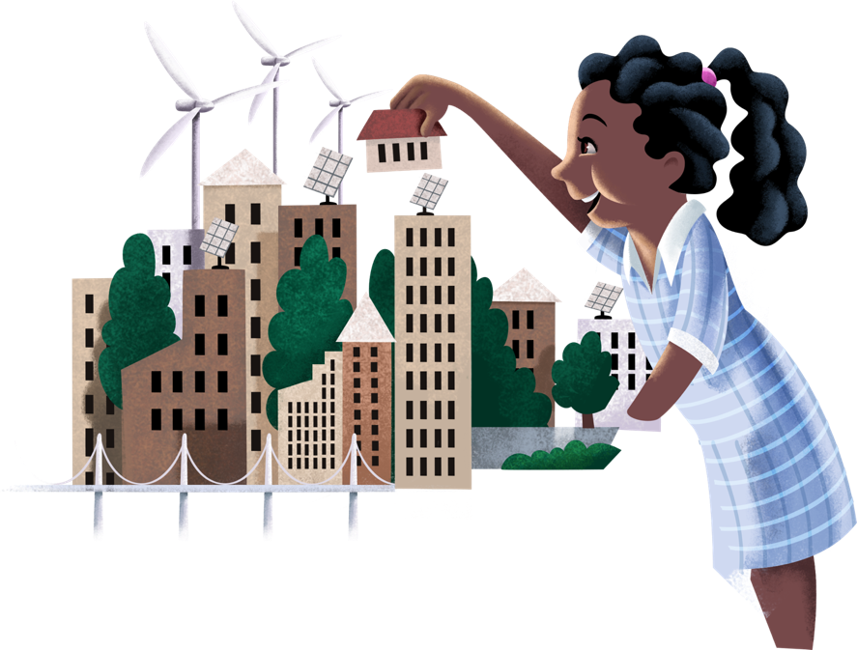
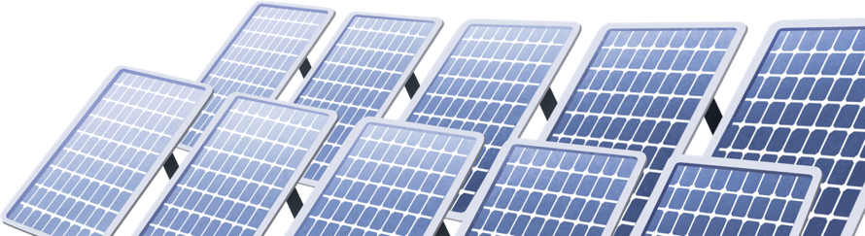
Smart Cities
What will cities look like in the future?
How are cities becoming ‘smarter’?
A smart city uses lots of connected technologies.
Smart technologies ‘talk’ to each other to make
people’s lives easier. Some of the connected
technologies in a smart city include:
street lighting
traffic & transport
wifi
pollution monitoring.
In the future, self-driving cars are likely to become common on our roads. These cars will communicate with each other to make our roads safer for drivers and pedestrians.
Some cities also provide people with pollution and noise monitoring devices to put on their balconies at home. These devices gather and share information about the local environment. How is this useful?

Slide 7

Text: Conversation Starter!
Partner Prattle...
Discuss your ideas with a partner, then share them with the class.

Slide 8
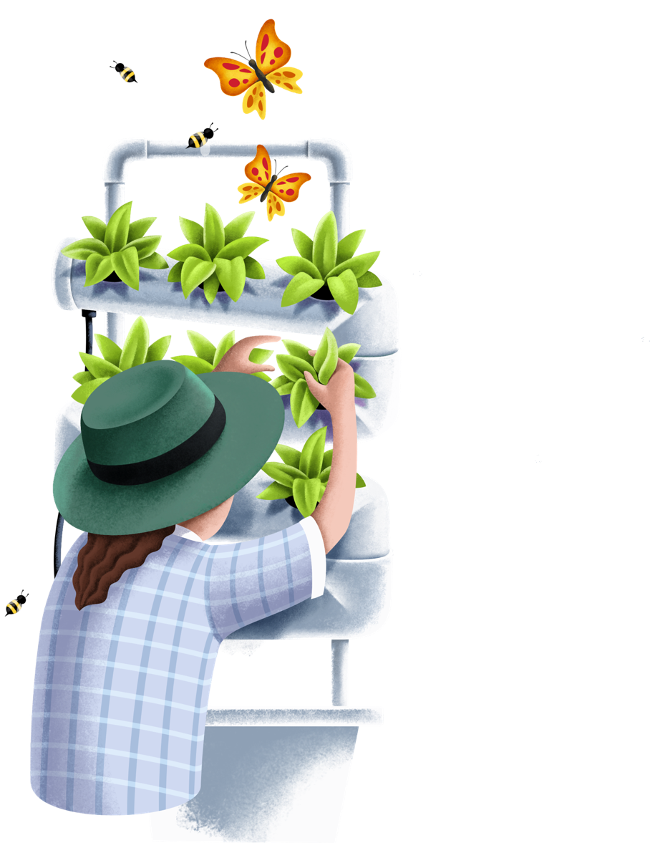




Hydroponics: Sustainable Food Production
Hydroponics is a method of growing plants without soil. Farmers can grow food inside, where they can control the temperature, how much water is used and the exact amount of nutrients their crops receive.
Hydroponics can be used to grow food in places with:
poor soil
poor light
challenging weather conditions
inadequate access to water.
A hydroponic farm uses much less water than a traditional farm and can grow five to ten times more food than a traditional farm taking up the same amount of space.
Hydroponics could be a great way to produce large amounts of food in the future? Why is this?
It would be awesome to have a hydroponic garden in your school. You and your friends could learn about different types of plants, plant nutrients, water consumption and good nutrition!
You could write a letter to your school leaders asking them to help your class create an interactive hydroponic garden!

Slide 9
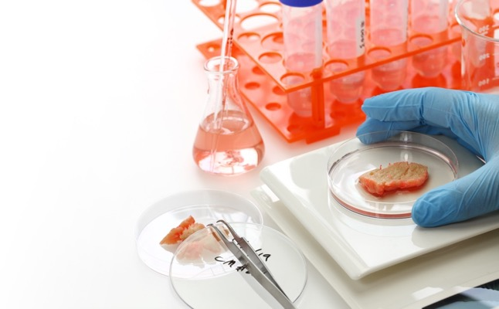
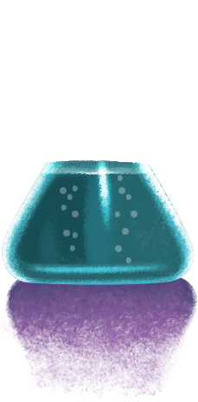
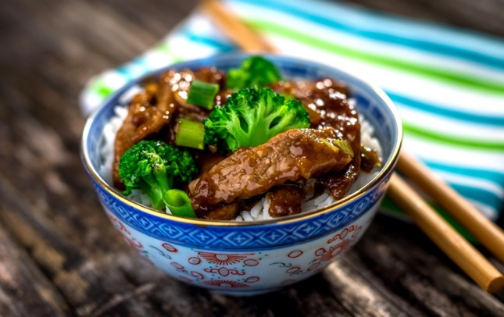

Lab-Grown Meat Sustainable Food Production
Scientists are now able to grow real animal meat in labs.
Is this a good thing? Let’s investigate.
The way food is produced is changing to keep up with the growing global population. However there is still extreme food poverty with lots of people not having access to the nutrition they need. In developed countries there is also a huge amount of wasted food.
Scientists are developing new ways to produce food. Some benefits of this may include:
more food, particularly protein, for hungry people
less stress on the soil
less stress on our water supplies
fewer greenhouse gas emissions, which lead to damaging climate change.
Scientists have even grown animal meat from cells in a lab. This is real meat produced in a test tube. No animals are harmed in its production. For many people this a strange and challenging idea.
Would you try meat grown in a test tube?
What problems might there be with lab-produced foods?
What do you think lab-produced meat might taste like?
Why might this meat be better for the environment than farm-produced meat?

Slide 10
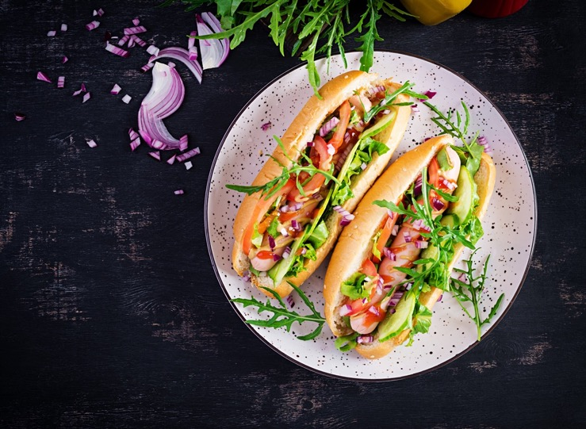
Text: Quick Quiz! 2

Slide 11
Answer! 2
That’s very expensive. But the cost of producing food this way is coming down very quickly.
The first lab-grown animal meat patty was produced in 2013 by a scientist in the Netherlands.
There are now many companies around the world that are using cutting-edge technology to grow chicken, beef and pork in labs.
The aim is to make meat in a lab that looks and tastes exactly like naturally produced meat.

Slide 12

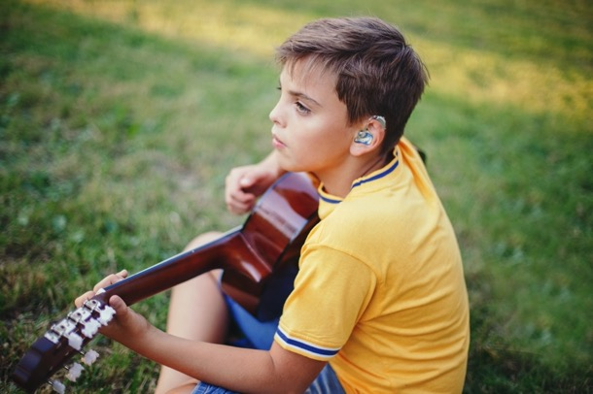
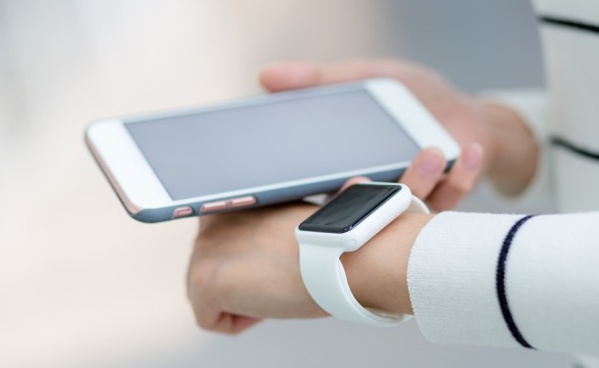
Smart Body Tech: Wearables
Smart technology for personal use has come a long way in the last 20 years. Some of the personal and wearable smart tech we now use includes:
smartphones
smart watches
cochlear implants (implanted devices to aid hearing)
apps to monitor blood health, including blood sugar levels
connected heart-rate monitors
health-tracking smart rings
smart glasses.
These wearable technologies support people with medical conditions or disabilities better than ever before.
What wearable technology could help you or someone in your family? How?
How might wearable technology change in the future? What could it allow us to do?

Slide 13
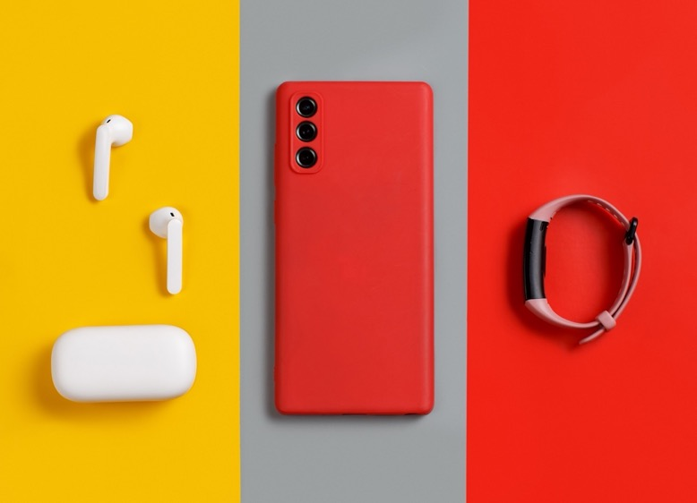
Quick Quiz! 3

Slide 14
Answer! 3
Here are some things wearable tech can track:
heart rate
temperature
breathing
step count and movement
Location
financial activity (contactless payments)
sleep
mindfulness
medical conditions
And that’s just the beginning.

Slide 15

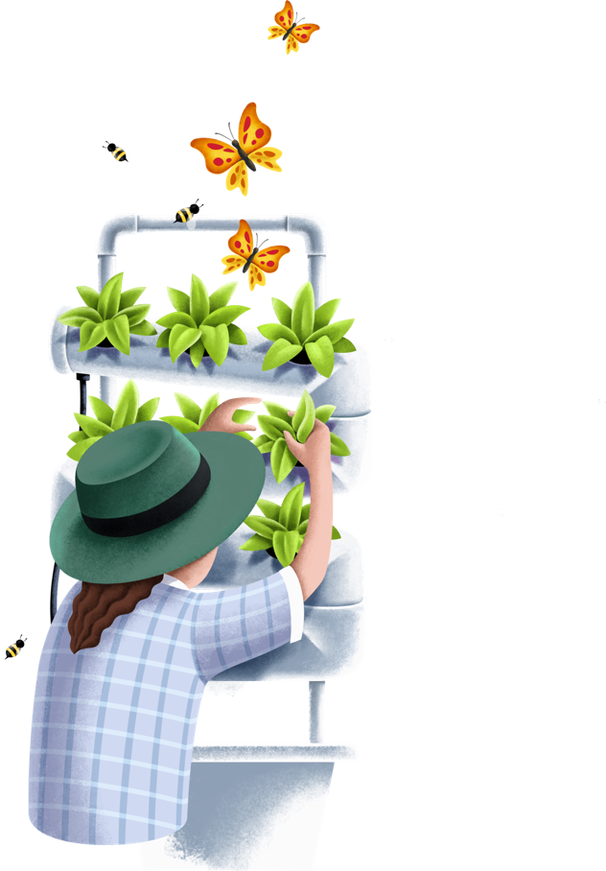





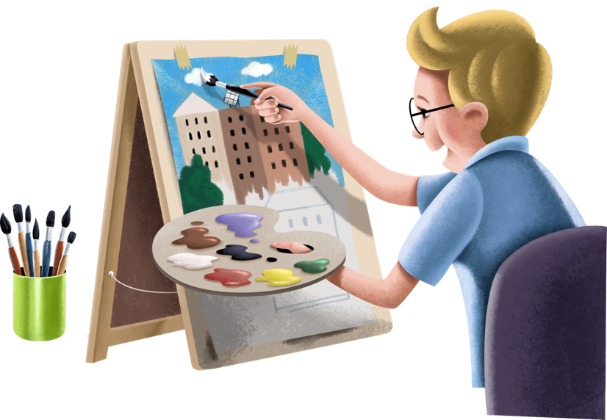
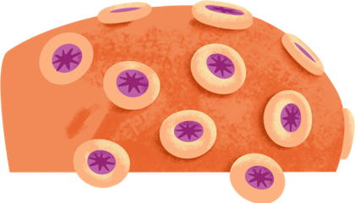

Next Steps
The ideas in this interactive slideshow are developed in the Stamp Collecting Month 2021 Teacher Activity Guides.
Download the Teacher Guides for follow-up student activities and investigations.
Full STEAM Ahead!

