Slide 1



Aiming for the Stars

Slide 2


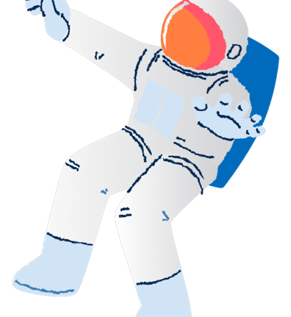
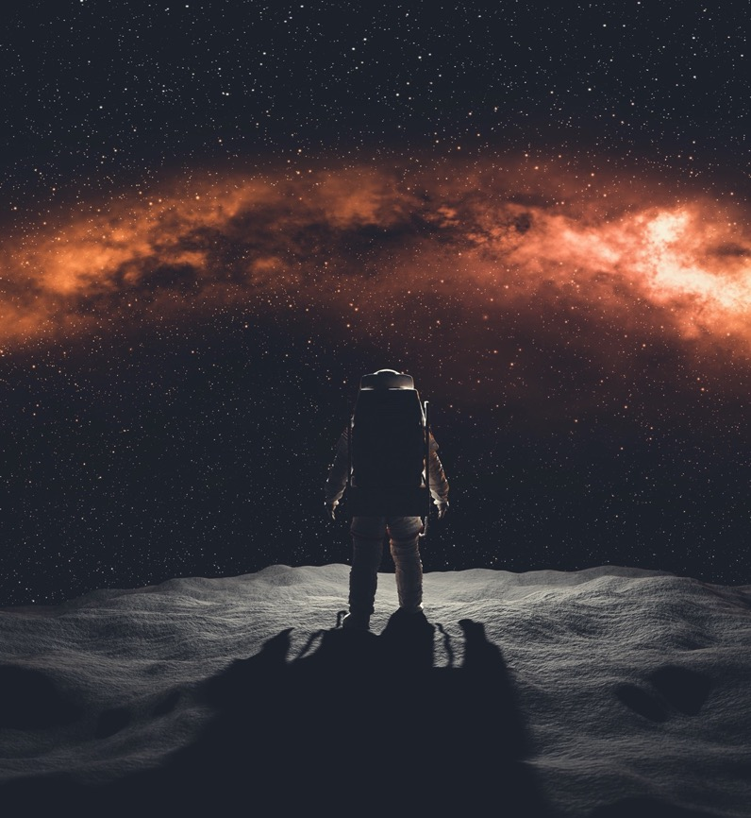
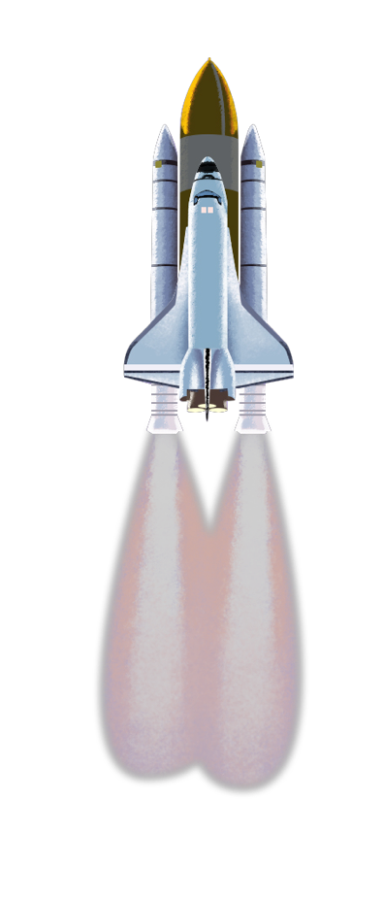
Who is the slideshow for?
Space has always inspired people, young and old. It continues to be a great source of wonder in our lives. Space seems closer than ever before.
This READ ALOUD Interactive Slideshow is for primary classes taking part in Australia Post Stamp Collecting Month 2021. It introduces the Aiming for the Stars! unit, one of three innovation themes of this year’s Full STEAM Ahead! program.
The slideshow introduces students to space exploration and features background information, quizzes and thought-provoking discussion questions intended to extend your students’ thinking about technology and STEAM-learning.
Teachers should read through and discuss this slideshow with their class. Some of the topics discussed raise ethical issues. Teachers should use their discretion when introducing some of these themes.
The content in this slideshow is linked to the Australian Curriculum. For more detail, please see the Australia Post Stamp Collecting Month 2021 Teacher Guides.
The Teacher Guides provide a range of complementary activities and investigations.
How might new discoveries in space help us? What are the new frontiers?

Slide 3

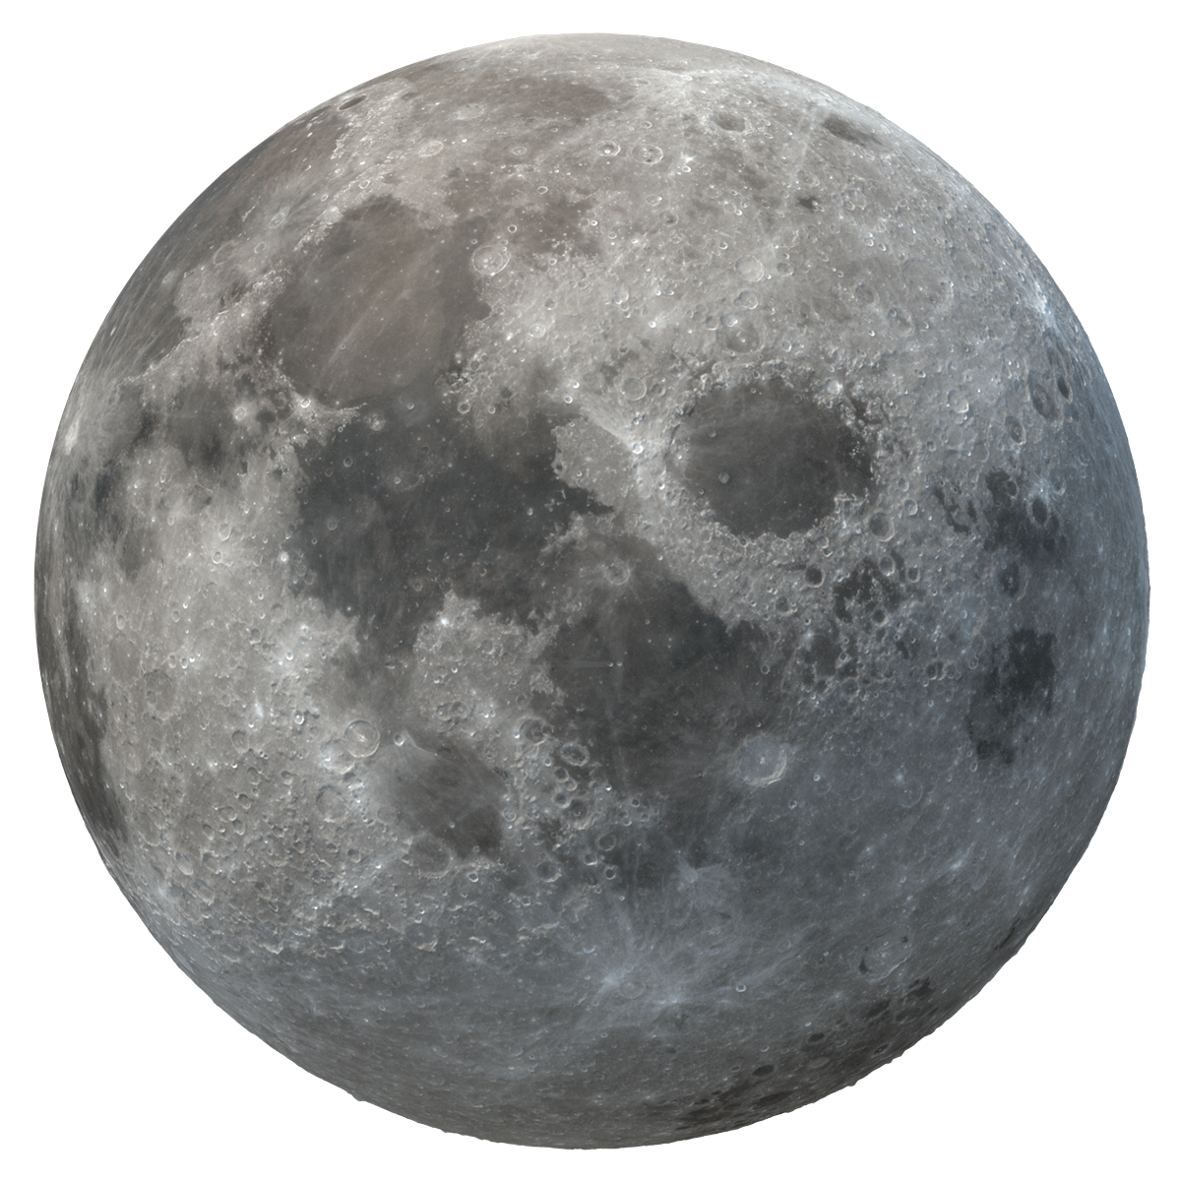
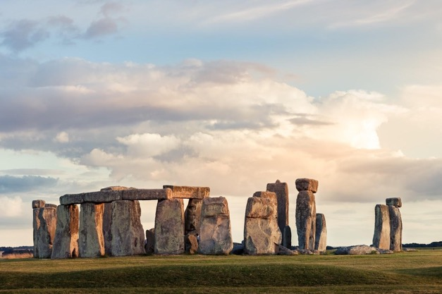
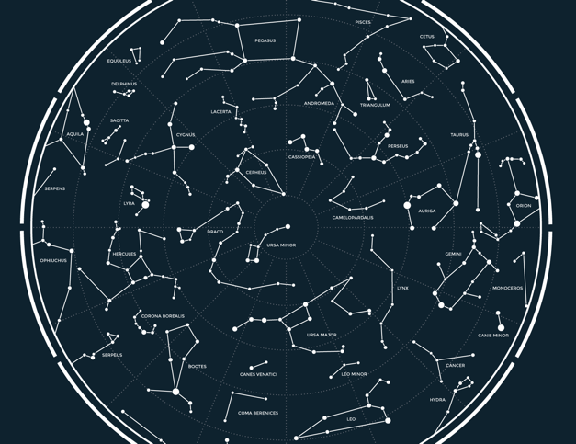
Ancient Societies & the Night Sky
For thousands of years, humans have been fascinated by the stars.
Which ancient societies do you think were most fascinated by space and the stars? All of them were!
Ancient Egyptians, ancient Chinese, First Nations Australians, Incas, and many other ancient peoples studied “the heavens”.
They used their understanding of space to:
make calendars
make clocks
predict the seasons.
They knew that studying space could help them understand their own planet, Earth. Space and “the heavens” have also played an important role in many religions.

Slide 4
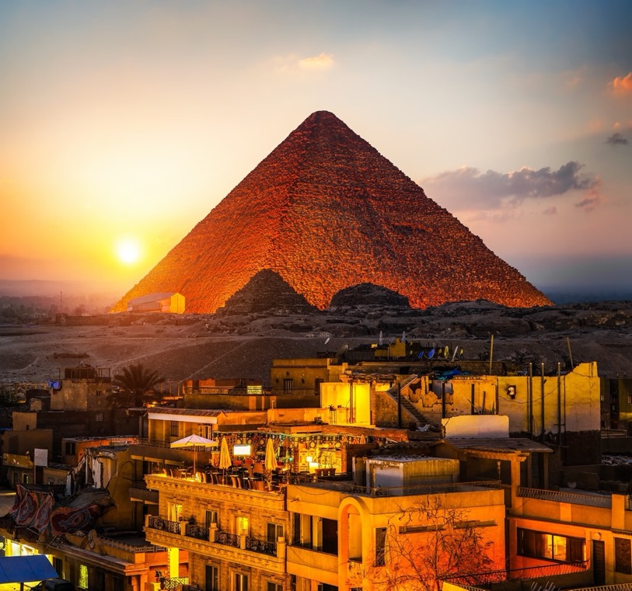
Quick Quiz! 1
The pyramids in Giza, Egypt, are probably the most famous ancient site in the world. They were the burial place for Egyptian pharaohs (kings) and played a very important religious role in ancient Egyptian society.
The ancient Egyptians took detailed measurements of the Sun and the stars.
Many experts believe the ancient Egyptians used these measurements of the Sun and the stars when designing the layout of the pyramids. We are still trying to figure out exactly why they did this.
Approximately how old do you think the Great Pyramid of Giza is?
500 years old
1,000 years old
c) 2,500 years old
d) 200,000 years old

Slide 5
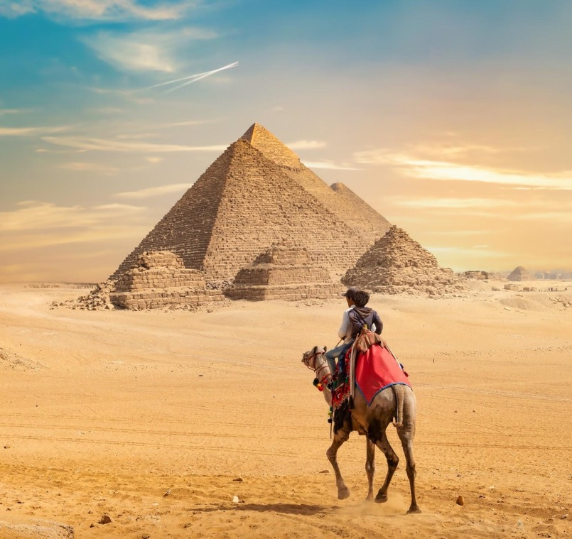
Answer! 1
c) 2,500 years old
Construction of the pyramid started around 2,580 BCE*, and it took around 20 years to build.
Herodotus, an ancient Greek historian, wrote that almost 100,000 workers helped to build the Great Pyramid of Giza.

Slide 6


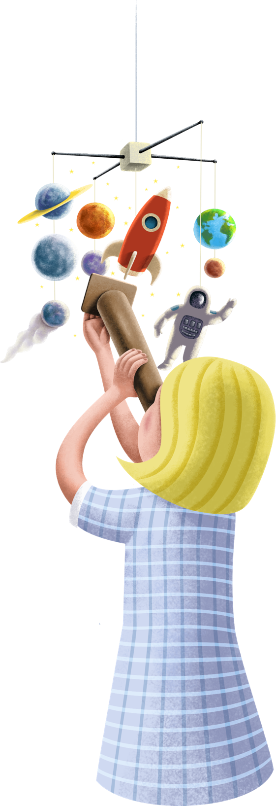
Space Basics!
Have you ever seen a picture or a model of the solar system? What is it?
What is the universe?
The solar system is the Sun and the eight planets that circle or orbit the Sun, including Earth.
The Sun provides Earth with light and heat. Without the Sun we would not be able to live.
The universe is everything. It includes every planet, moon, asteroid, star, galaxy, and lots more. The universe is all the space we can and cannot see. It is nearly 14 billion years old.

Slide 7
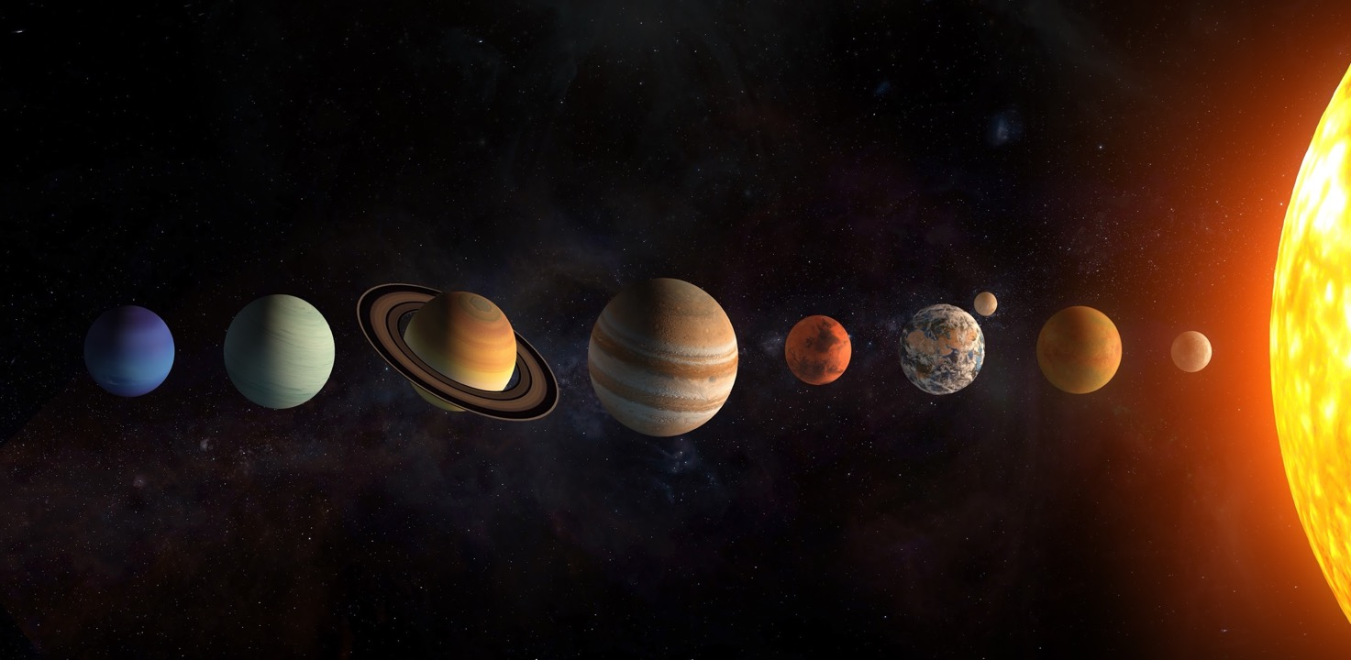
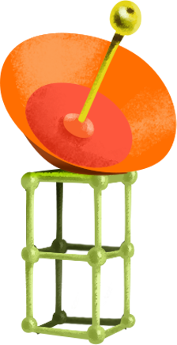
Conversation Starter!
If you could travel out into the solar system, which planet would you like to visit? Why? What might be some challenges of visiting your planet?
What makes Earth such a good planet for humans, and other animals and plants, to live on?
Partner Prattle!
Discuss your ideas with a partner, then share them with the class.

Slide 8
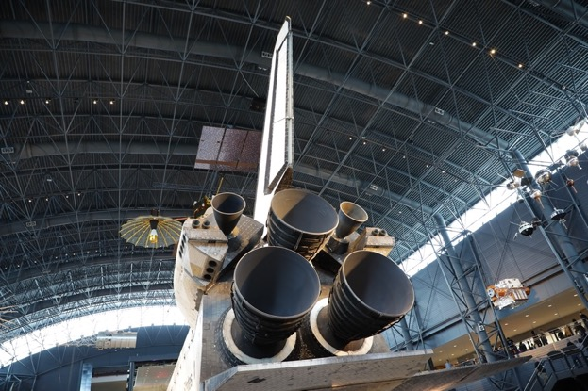
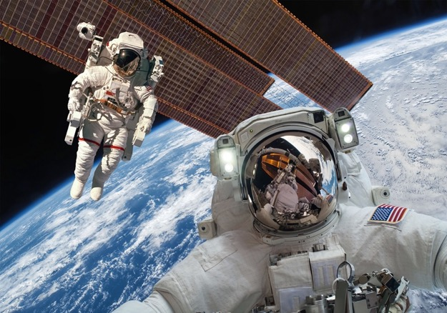
The First Phase of Space Exploration
Before humans travelled to space, they first sent monkeys, dogs, cats, tortoises, birds, and even fruit flies.
Why do you think we sent animals into space first? Is this fair?
Humans first visited the Moon in 1969, but astronauts had already been traveling into space for eight years before the Moon-landing.
No-one has been to the moon since 1972, almost 50 years ago.
What challenges do you think the first astronauts faced?
More than 500 astronauts from more than 40 countries have since been to space, and more than 10,000 satellites have also been launched.
Satellites orbit Earth while:
taking photos
conducting scientific experiments, and
helping us communicate by mobile phone.
The International Space Station is a very special satellite on which astronauts from different countries live together and study how space affects humans.

Slide 9
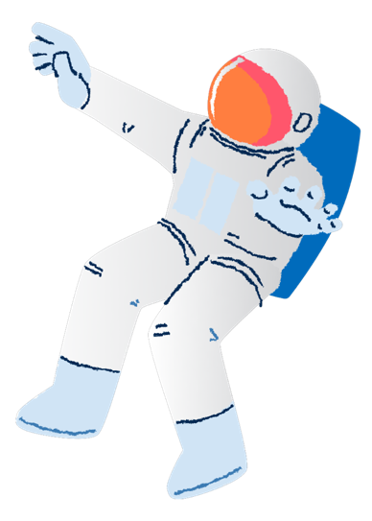

Quick Quiz! 2
10, 9, 8, 7, 6, 5, 4, 3, 2, 1, 0… LIFT OFF!
Who was the first human to travel into space?
Buzz Aldrin
Neil Armstrong
Uri Geller
Yuri Gagarin
BONUS: Where were they from?

Slide 10
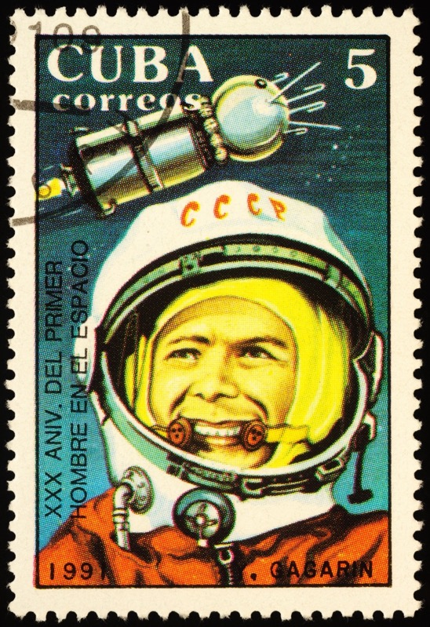
Answer! 2
(d) Yuri Gagarin was the first human to travel into space, over 60 years ago, in 1961.
He was from the Soviet Union.
He orbited Earth in 89 minutes, in a space capsule called Vostok 1.
The first woman in space was Valentina Tereshkova, who flew on Vostok 3 two years later. She was also from the Soviet Union.

Slide 11
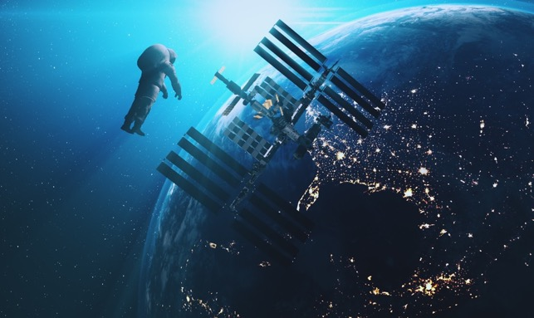
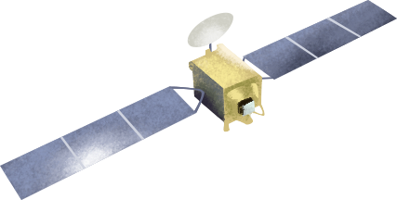
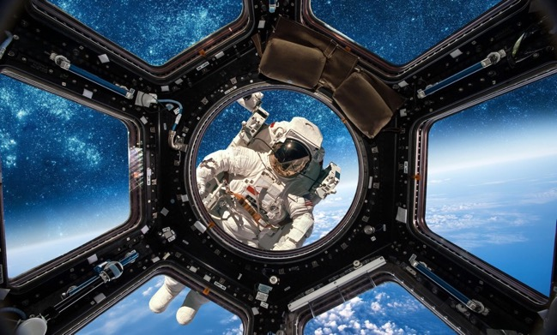
Space Exploration: New Frontiers
There is still so much we can learn from space. Lots of governments and businesses are working hard to send astronauts and spacecraft to places we have never been.
Scientists still have lots of unanswered questions, such as:
Will astronauts be able to travel to Mars? And even live there?
Will discoveries in space help solve problems on Earth, like climate change?
Will people like us be able to travel to space just for a holiday?
What do you think?
We need lots of hard-working, talented, passionate young people like you to help solve some of the big questions about space

Slide 12

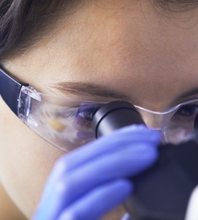

Quick Quiz! 3
What types of workers are needed in space programs around the world?

Slide 13
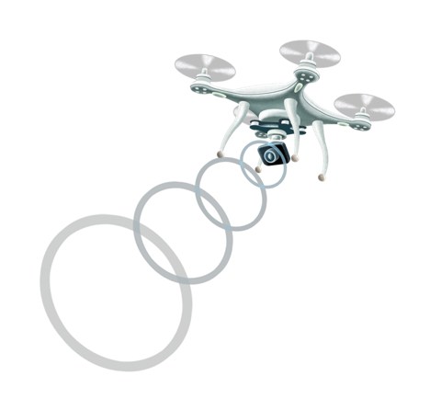

Answer! 3
There are so many different people working together to make space exploration possible.
Here are just a few of the careers you could have in the space industry:
computer scientist
mathematician
mechanic
astronomer
scientist
engineer
meteorologist (weather experts)
photographer
doctor
spokesperson
Are you ready? 10, 9, 8, 7, 6, 5, 4, 3, 2, 1, 0…LIFT OFF!

Slide 14







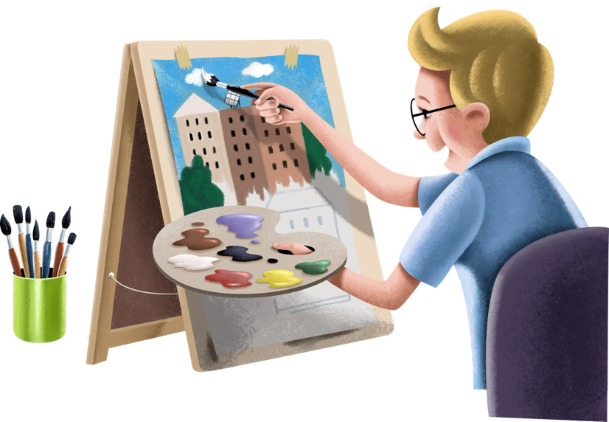


Next Steps
The ideas in this interactive slideshow are developed in the Stamp Collecting Month 2021 Teacher Activity Guides.
Download the Teacher Guides for follow-up student activities and investigations.
Full STEAM Ahead!

