Slide 1
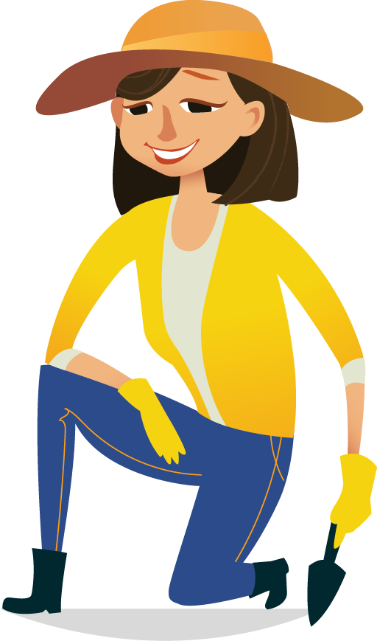
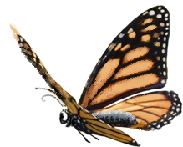

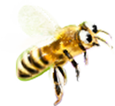
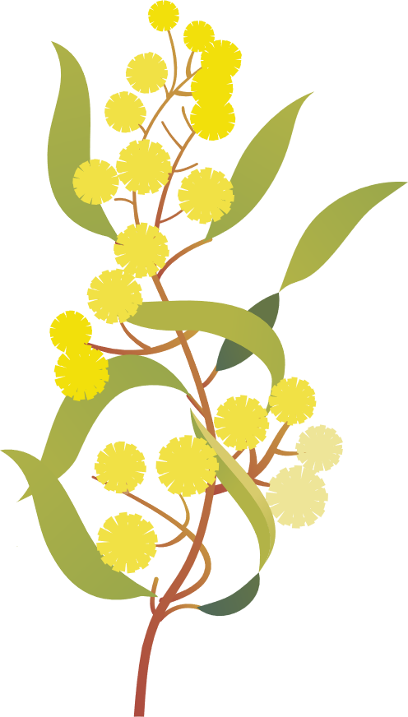

How can we sustainably support our native pollinators while contributing to our school’s kitchen throughout the year?

Slide 2
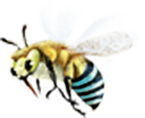

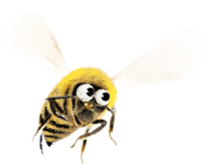

Initial thoughts...

Slide 3
What do we already know?

Slide 4
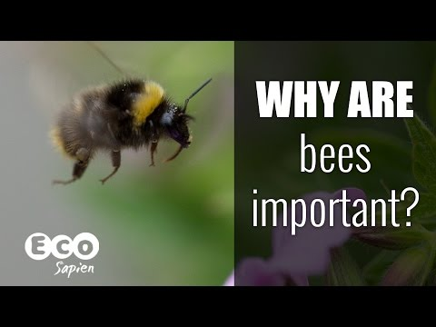
Notes:
https://www.youtube.com/watch?v=YaaQUGPXtnU&t=51s
Can we embed this video?

Slide 5
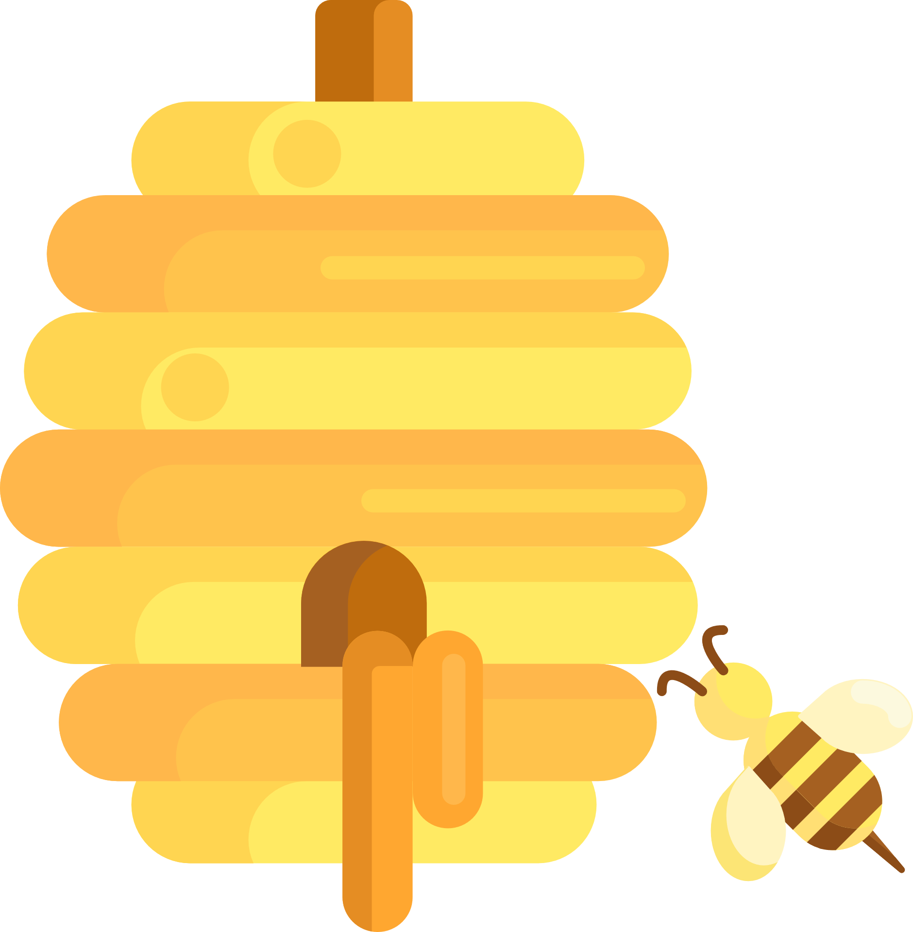
Building a HIVE of knowledge
Why do we need bees?

Slide 6
Building a HIVE of knowledge
What can affect bee habitats?

Slide 7
Building a HIVE of knowledge
What do bees need from us?

Slide 8
Building a HIVE of knowledge
How do bees support the environment?

Slide 9
Building a HIVE of knowledge
What are the possible consequences of bees disappearing?

Slide 10



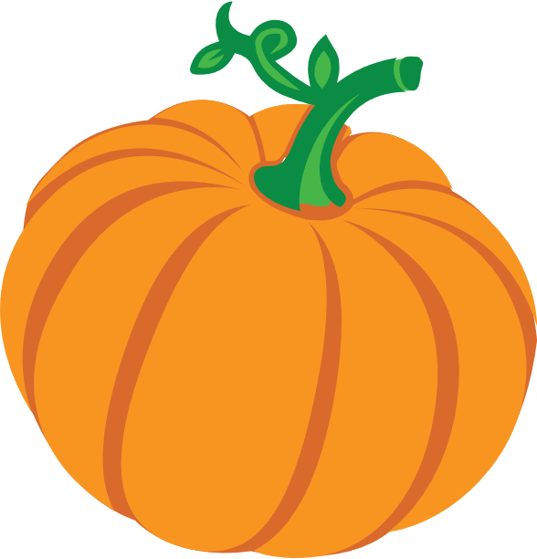
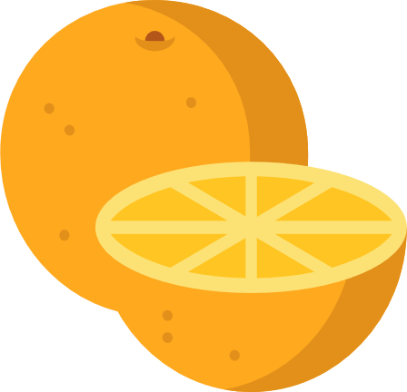
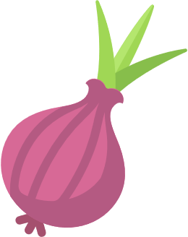
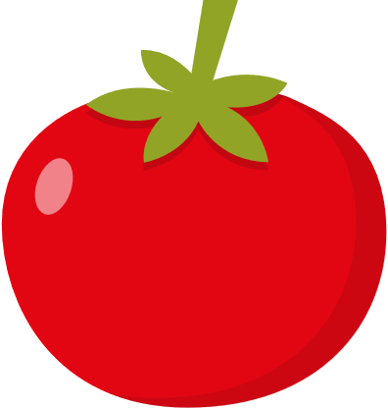



Comparing Fruit and Veggie needs
Plant
When to plant
Type of soil
Amount of sunshine
Type of climate
Amount of water
Food needs
Other notes

Slide 11
Comparing Fruit and Veggie needs
Plant
When to plant
Type of soil
Amount of sunshine
Type of climate
Amount of water
Food needs
Other notes

Slide 12
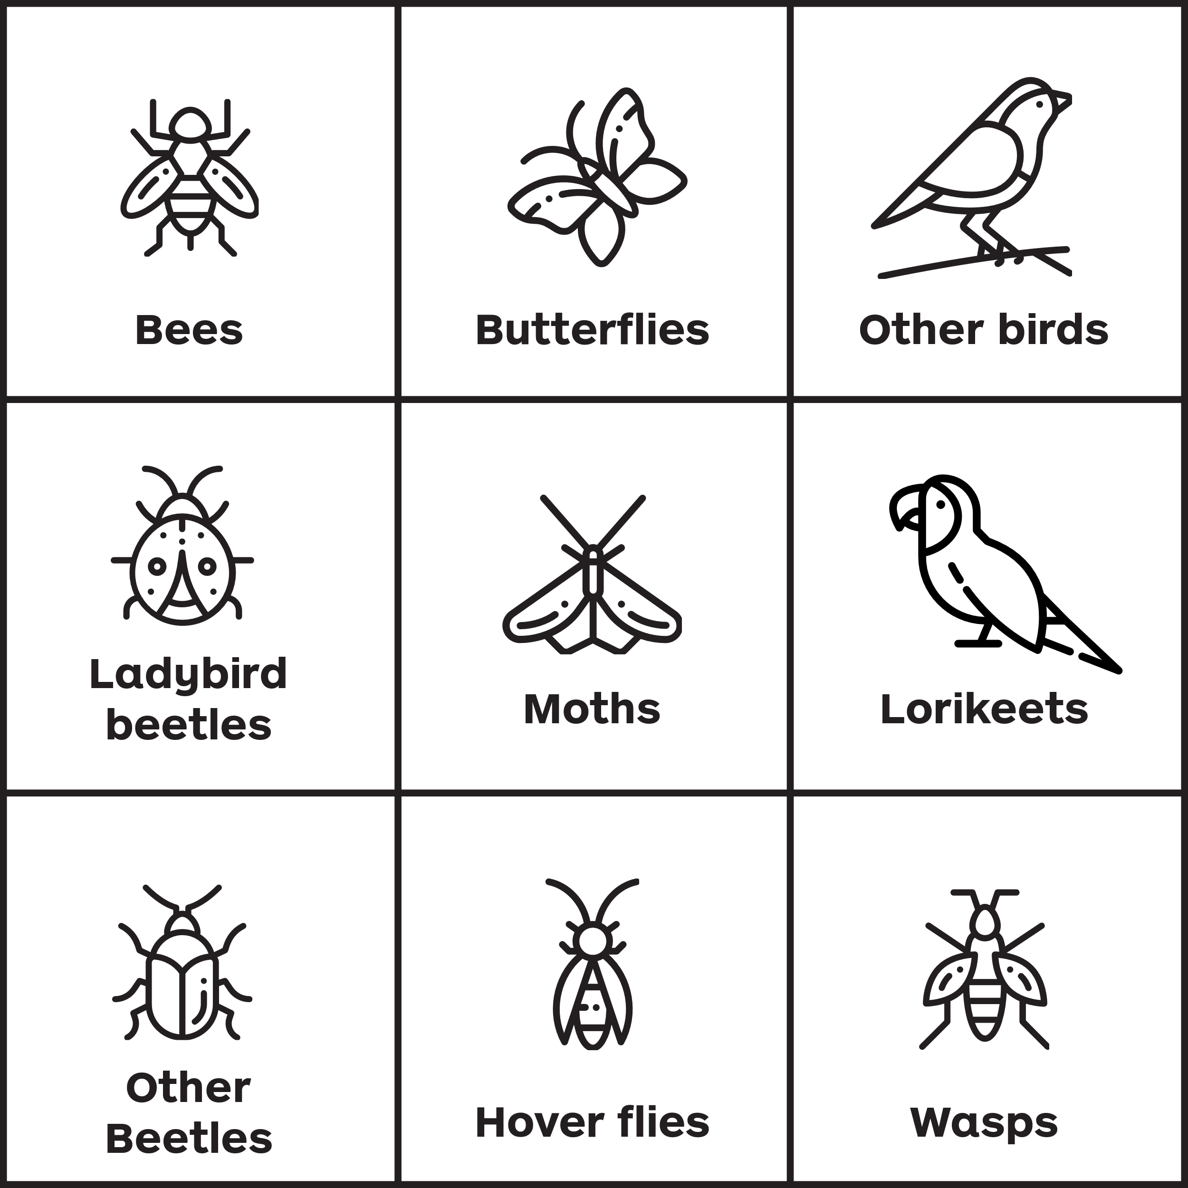
Pollinator Bingo
Observe your veggie patch and tick off the pollinator you spot!
Who will be the first to complete the grid?

