Slide 1


What does it mean
to be
Water Wise?

Slide 2



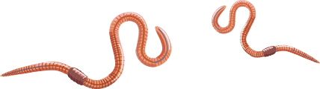
Ways to be Water Wise
INSIDE
OUTSIDE

Slide 3
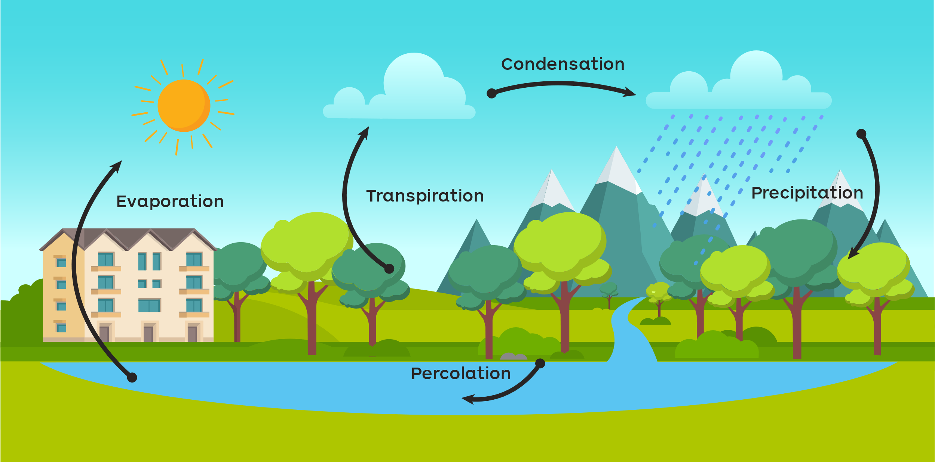
The Water Cycle

Slide 4
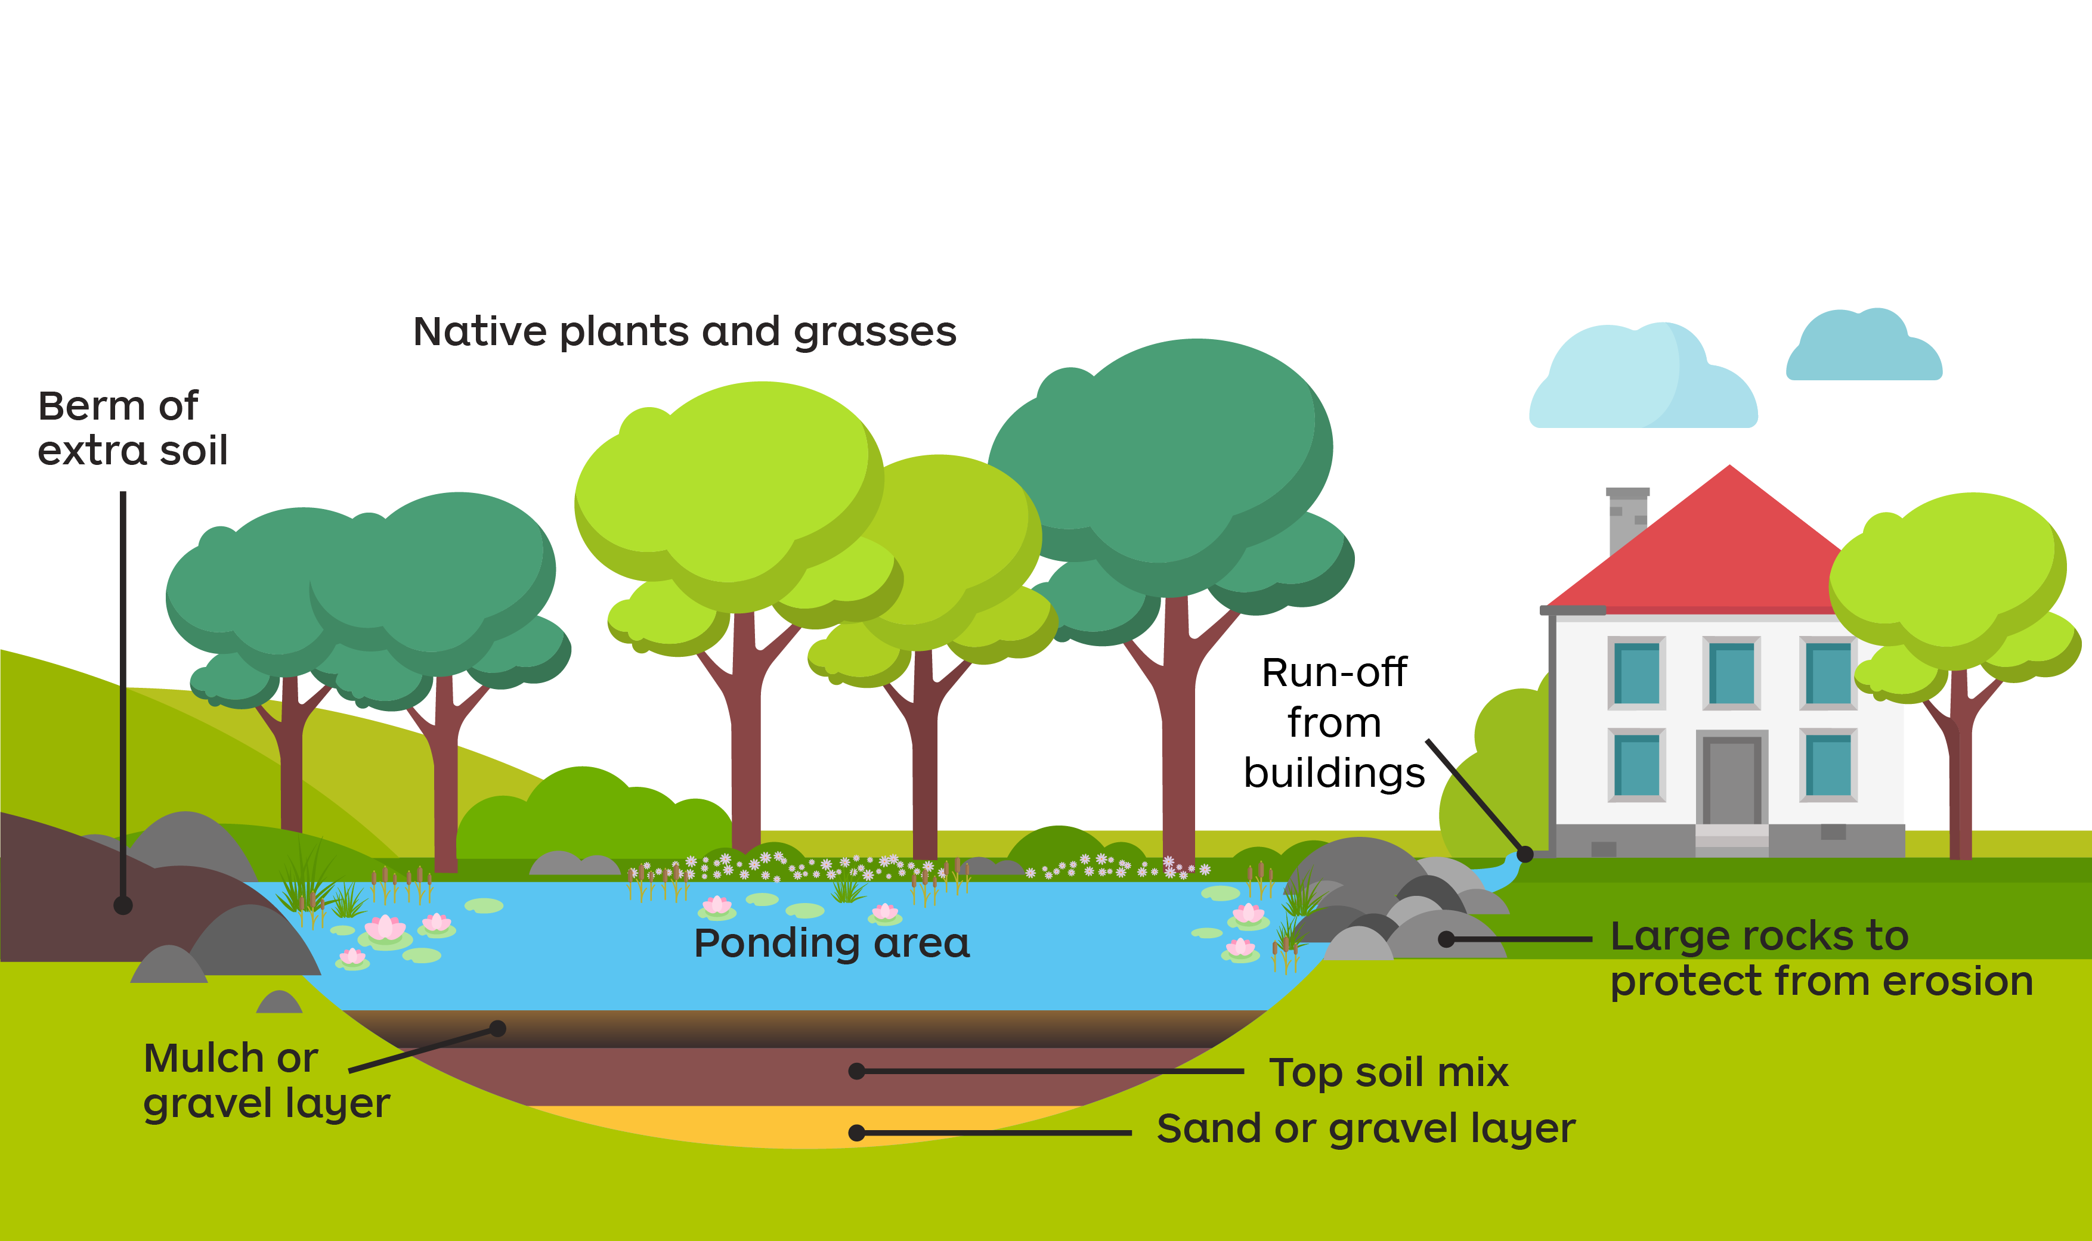
Rainwater Garden

