Slide 1
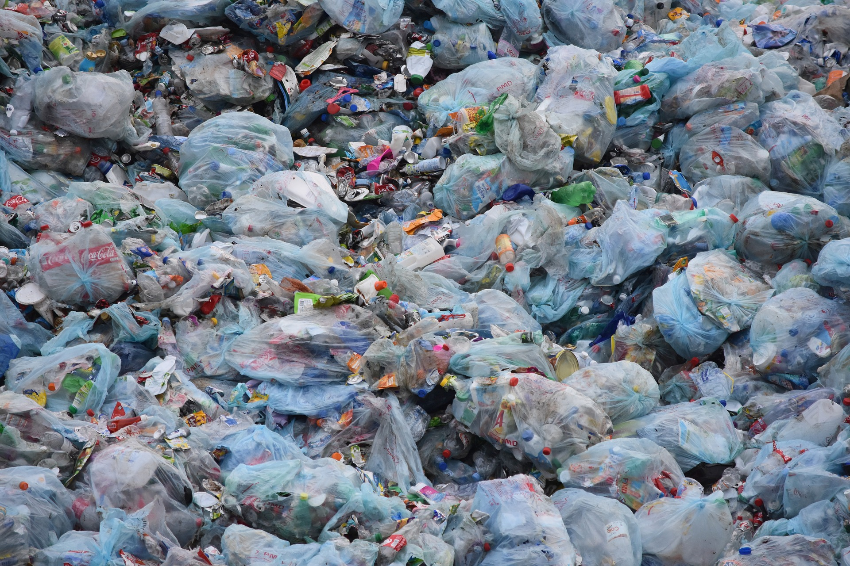

Slide 2



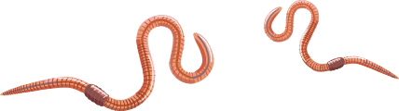
Wonderful Worms
Worms can
Worms have
Worms are

Slide 3
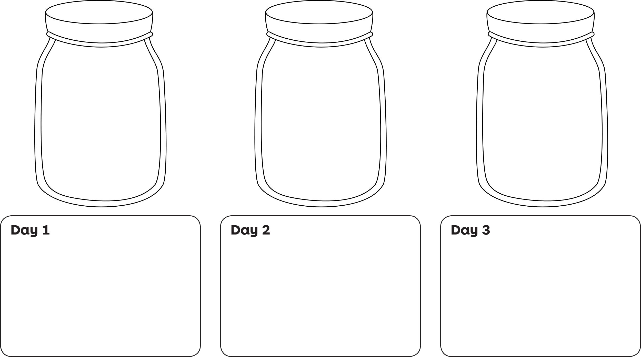
Worm-servations
Each day observe and draw a diagram of what your worm jar looks like. Note any changes you see.

Slide 4
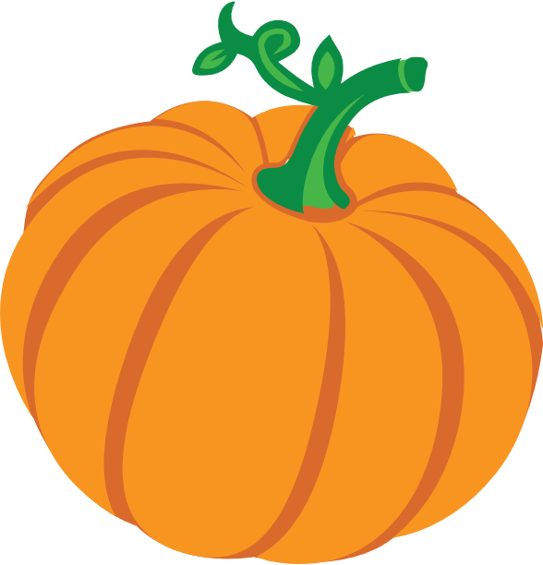
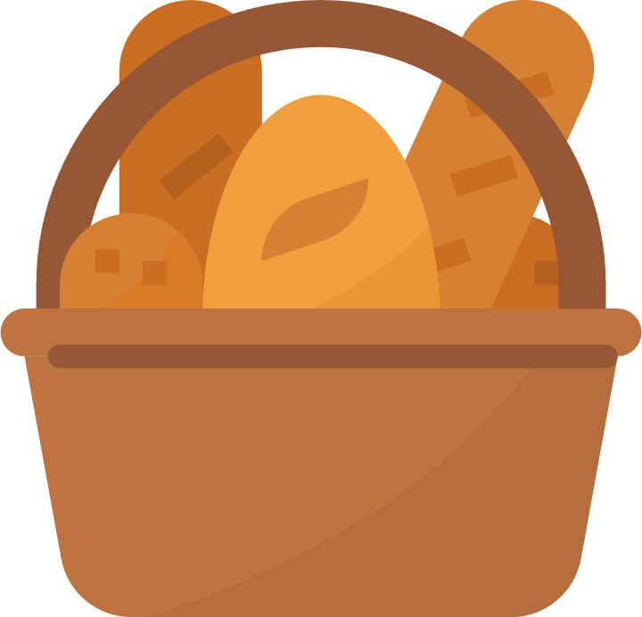

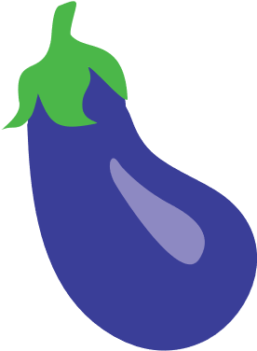
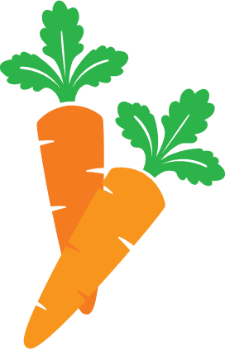

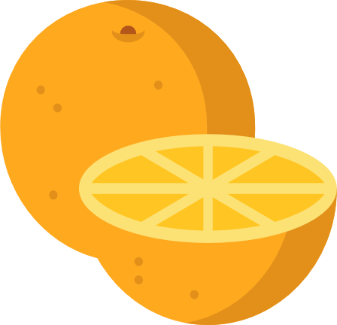
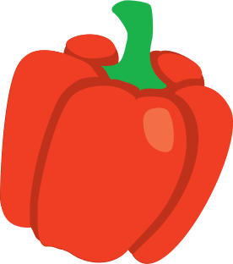


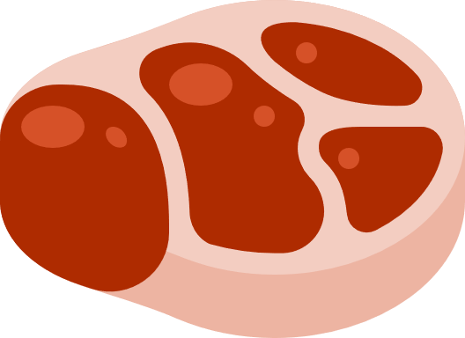

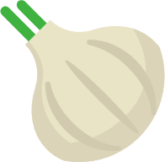
Wonderful Worms
DO
Anything green and leafy
Fruits
Vegetables
Coffee grounds
DON’T
Citrus
Bread
Meat
Cheese
Garlic
Onions
Tea bags
Newspaper

